Slide 1
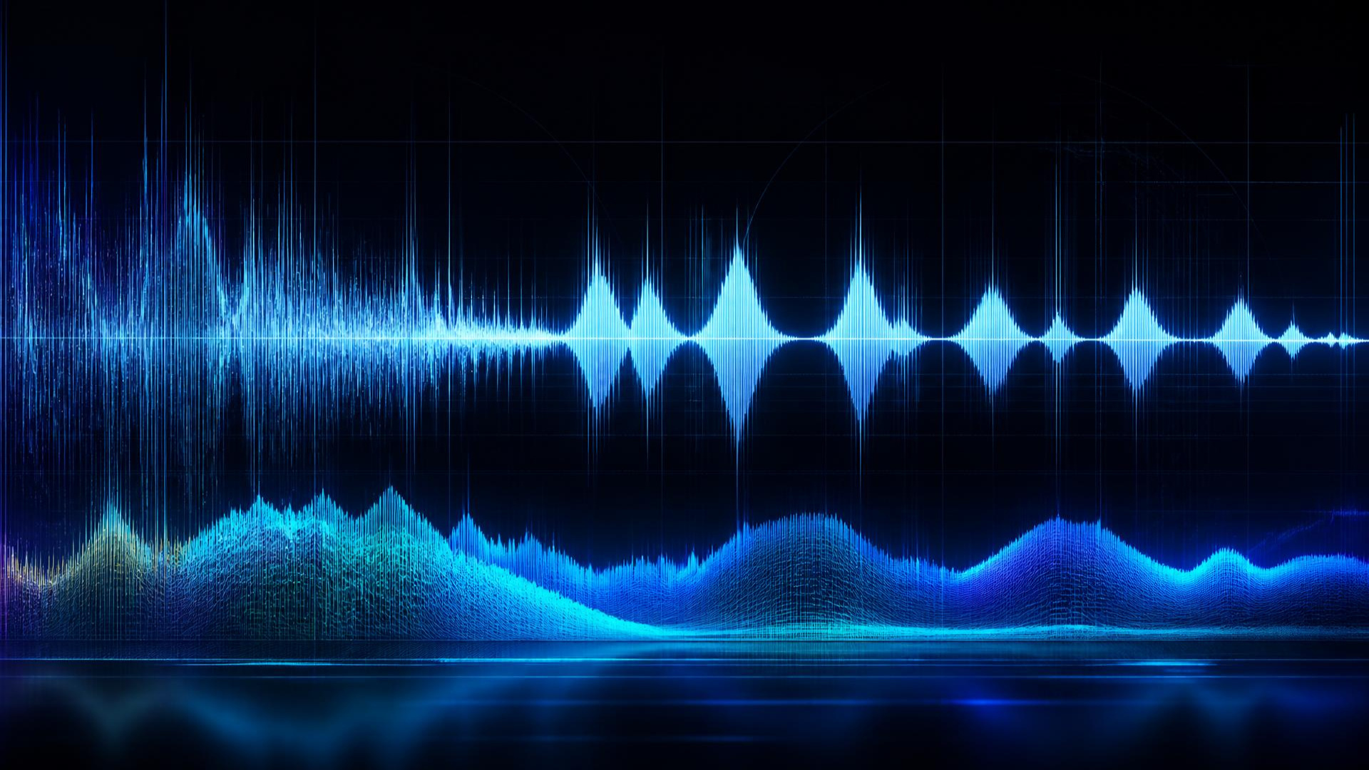
B.TECH ECE • FIRST REVIEW • 2025–26
SPEECH
ENHANCEMENT
AND NOISE REMOVAL
R. Sai Samartha Reddy · Sriram Kanuri · Rishi Vardhan
Guide Dr. V Sahiti
Department of Electronics and Communication Engineering
KL University, Hyderabad

Slide 2
PROJECT MAP
AGENDA
01
Introduction
07
System Requirements
02
Problem Statement
08
Phase 1 Results
03
Objectives
09
Expected Outcomes
04
Literature Survey
10
Future Scope
05
Existing vs Proposed
11
References
06
Proposed Methodology

Slide 3
01 / CONTEXT
Why speech enhancement?
BACKGROUND
PROPOSED IDEA
Real-world recordings carry background noise that reduces intelligibility, degrades communication quality, and weakens speech-based applications.
Build a software DSP pipeline: inspect speech with FFT, suppress unwanted components using digital filtering, then evaluate SNR, waveform, and spectrum changes.
TIME DOMAIN / NOISY INPUT
FREQUENCY DOMAIN / SPECTRUM

Slide 4
02 / PROBLEM
Noise hides what
matters in speech.
Speech recorded in practical environments is contaminated by unwanted background noise.
REDUCED CLARITY
DISTORTED SPEECH COMPONENTS
LOWER SIGNAL QUALITY
POORER APPLICATION RELIABILITY
THE NEED
A reliable, measurable method to reduce noise while preserving key speech features.

Slide 5
03 / OBJECTIVES
Preserve speech.
Remove noise.
SECONDARY OBJECTIVES
FFT analysis of noisy speech
Digital filter for attenuation
Original · noisy · enhanced comparison
Frequency spectra before / after
SNR calculation
Reproducible Python implementation
PRIMARY OBJECTIVE
Reduce unwanted noise while preserving important speech information.
SUCCESS MEASURE
ΔSNR > 0 dB

Slide 6
04 / EVIDENCE BASE
Literature survey
AUTHOR / YEAR
METHOD
CONTRIBUTION
GAP
S. F. Boll, 1979
Spectral Subtraction
Frequency-domain suppression
Residual artifacts
Ephraim & Malah, 1984
MMSE-STSA
Statistical enhancement
Computational complexity
Ephraim & Malah, 1985
MMSE-LSA
Log-spectral enhancement
Statistical estimation
Scalart & Vieira Filho, 1996
A-priori SNR
Improved frequency enhancement
Noise-estimation dependent
RESEARCH GAP
Effective methods often require statistical modeling or added computational complexity. Our baseline prioritizes transparency, reproducibility, and extensibility to ML.
Boll (1979), IEEE TASSP · Ephraim & Malah (1984; 1985), IEEE TASSP · Scalart & Vieira Filho (1996), ICASSP

Slide 7
05 / SYSTEM COMPARISON
From basic reduction
to a measurable pipeline
EXISTING SYSTEM
PROPOSED SYSTEM
Conventional techniques
Limited frequency analysis
Limited quantitative evaluation
Manual / less reproducible
No integrated comparison
Python-based DSP
Controlled noise testing
FFT frequency analysis
6th-order Butterworth filtering
SNR + waveform + spectrum
Reproducible software workflow
KEY IMPROVEMENT · analysis + filtering + visualization + SNR evaluation

Slide 8
06 / PROPOSED METHODOLOGY
Signal in. Evidence out.
SPEECH
INPUT
PRE-
PROCESS
MONO +
NORMALIZE
ADD
NOISE
FFT
ANALYSIS
BUTTERWORTH
LPF
ENHANCED
SPEECH
SNR +
COMPARE
1 Read WAV · mono + normalize
2 Add Gaussian white noise
3 FFT frequency analysis
4 6th-order Butterworth LPF @ 4 kHz
5 SNR + waveform + spectrum comparison
SOFTWARE-ONLY / REPRODUCIBLE BASELINE

Slide 9
07 / SYSTEM REQUIREMENTS
Lean by design
SOFTWARE
HARDWARE
IMPLEMENTATION
Python 3
NumPy · SciPy · Matplotlib
Windows / Linux
Terminal or Python environment
WAV audio input
Modern x86-64 processor
Minimum 4 GB RAM
≈ 1 GB+ storage
No dedicated DSP hardware
100%
SOFTWARE

Slide 10
08 / PHASE 1 RESULTS
Filtering delivers a
measurable gain.
BASELINE EXPERIMENT
Speech WAV · Gaussian white noise
6th-order Butterworth LPF · 4 kHz cutoff
BEFORE
8.18 dB
AFTER
14.86 dB
OUTPUTS
Enhanced WAV · waveform comparison
frequency spectrum · SNR evaluation
+6.69 dB
SNR IMPROVEMENT

Slide 11


THANK YOU!
Your support and kindness mean the world to us. We are truly grateful.

